Slide 1
Purdue Process Safety & Assurance Center (P2SAC)
Overview
Ray A. Mentzer
Professor of Engineering Practice
Associate Director, P2SAC
Charles D. Davidson School of Chemical Engineering Purdue University
May 14, 2021

Slide 2
May 2021 Conference Registration
Guests
ABS
aeSolutions
Air Products
AstraZeneca
Bechtel
Boehringer Ingelheim*
Cadila
Carnegie Mellon*
CatSci Ltd*
CCPS
CDC - NIOSH
Celanese
Cenovus*
Chemours*
Cook
Cummins
DEKRA
DNV*
Dr Reddys*
Evonik
Exponent
ExxonMobil
Gilead
Hikla*
IChemE
Huntsman*
Johnson Matthey
Langan Eng
Mettler Toledo
Occidental
Promega Corp*
PSRG
Scale-Up Systems
SGGS, IET* (India)
Smith Burgess
Spark Cognition*
Tate & Lyle
Vertex
*denotes 1st meeting
Sponsors
ACC – Am Chem Council
AcuTech
AMGEN
BP
Chevron
Corteva
CountryMark
Dow
Endress+Hauser
Fauske & Associates
GSK
Honeywell
Kenexis
Lilly
Marsh Risk
Merck
Phillips 66
Pfizer
SABIC
3M
On-going dialog with other Depts:
ABE, CHEM, IE, IPPH & ME

Slide 3
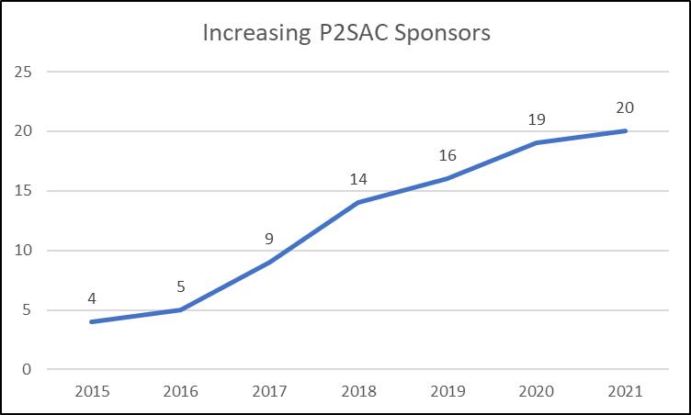
Growing Industry Participation in P2SAC

Slide 4
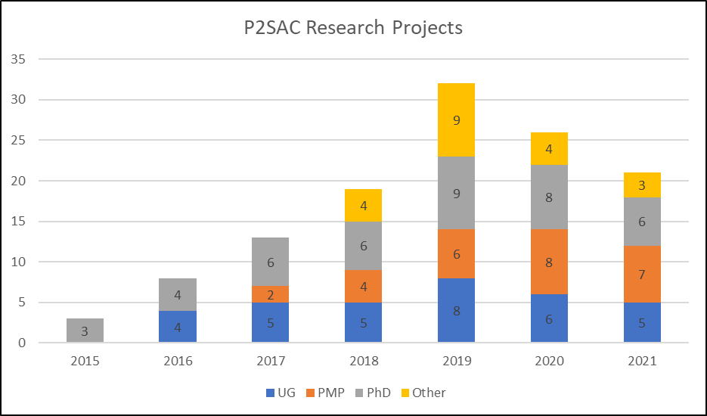
Growing P2SAC Research at all Academic Levels

Slide 5
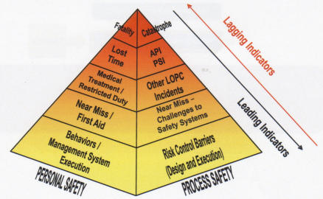
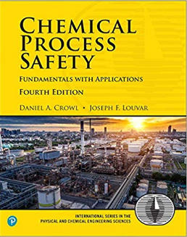
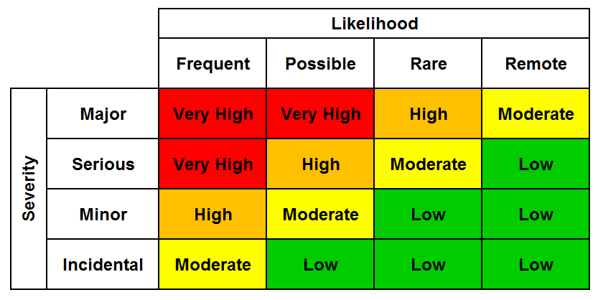
Chemical Process Safety - Core Class
Process Safety Metrics
Personnel vs. Process Safety
& Metrics
Applicable regulations: OSHA
PSM, EPA RMP, etc
Source Term Modeling
Toxicants & Industrial Hygiene
Toxic/Flammable Gas Release
Dispersion Modeling
Fire & Explosion Protection
Chemical Reactivity
Relief System Design
Hazards Identification (HAZOP, ..)
Risk Assessment (Matrix, QRA, ..)
Accident Investigations
LOPA Frequencies
Typical 4x4 Risk Matrix
HAZOP

Slide 6
P2SAC Related PMP Research 2020 / 2021
AcuTech - Real World Application of Artificial Intelligence and Machine Learning in Process Safety
AMGEN - Thermal Hazards in the Pharmaceutical Industry & continued in ‘21
BP - Safety Protection System Analysis / Common Cause Failures
Chevron - Safe Disposal of Drilling Fluids From High Temperature & Pressure Wells
- Drilling & Completions Fluids Management
Dow - Heat Transfer Model for Accelerating Rate Calorimeter
- Assessing efficacy of indirect contact water spray in arresting thermal runaway inside vessels
Fauske - Refine the Design of a Benchtop Prototype Device for Chemical Reactivity Screening
- Designing an Emergency Relief System for Vessels Containing Materials with Known and Unknown Decomposition Kinetics
Marsh - The Role of Shift Handover in Achieving Positive Process Safety Outcomes
Merck - Using experimental data to assess thermal hazards in pipes to protect flow reactors
Phillips 66 - Dispersion of H2S & NH3 from releases of sour water & rich amine treating solvent
Vertex (w / Amgen, Corteva, GSK, JP, Lilly, Merck) - Experimental vs. predicted heats of reaction for some common reaction types in pharma industry & comparison with predictions
3M - Modeling Indoor Release of Hazardous Chemicals
*Participated other years: Dow AgroSciences, ExxonMobil, Kenexis, Lilly, Shell

Slide 7
P2SAC 5-year Plan Survey
1. Describe your current experience with P2SAC. What have been the most valuable contributions to you, your company or industry?
excellent conference content & discussions; more ‘connected’ feel than other conferences
network & learn best practices from others … and unique opportunity to benchmark & learn from other industries – eg, heat of rxn collaboration
opportunity to influence other cos who have fewer process safety resources / experience, particularly on fundamental science
applicability of P2SAC research to industry
UG & PMP resource for project research important to cos and provides student development opportunity
2. How could your experience with P2SAC be improved?
pursue more projects; more industry collaborations
overall preference for F2F, while virtual conferences expand attendance …
annual PhD funding cycle to more frequently engage R&D arm of company; perhaps stagger cycle (half projects / yr)
improvements to process for assigning / onboarding PMP students
strict time limit on conference presentations

Slide 8
P2SAC 5-year Plan Survey (2)
3. What do you think are currently the most pressing process safety challenges in your company?
lab scale hazards and dust explosivity
lack of trained resources
design vs. actual performance of protection layers
dispersion modeling, CFD, AI and machine learning to improve PHAs
understanding process safety aspects of flow chemistry
early phase hazard evaluation with limited material for testing
future handling of renewable feedstocks
tool to assess company’s organizational health
4. What do you think are currently the most pressing process safety challenges in your industry or beyond?
aging equipment, retirement of key PS experts, cybersecurity, sustainability
effective communication of process safety risks to operators and senior mgmt
powder fires & explosions, shift from batch to continuous pharma processing
continuation of Amgen / P2SAC work on TMR24 as key safety parameter
model thermal hazards with slim data, such as AKTS
releases from storage tanks, ASTs (above ground storage tanks)
shorter process development time for new chemistry & PS impacts
natural disaster events leading to PS incidents (NanTech), process security, process safety culture, domino effects, application in other industries, digitalization

Slide 9
P2SAC 5-year Plan Survey (3)
5. How is P2SAC supporting you in addressing these company & industry process safety challenges?
Intercompany dialog, sharing of best practices, publications, research opportunities
Providing a forum for companies to network & collaborate
Broad range of topics and papers at conferences
Helps consulting firms understand potential client needs
6. Looking ahead, how could P2SAC support you in addressing these company & industry process safety challenges?
influence ABET to ensure all ChE & Chem pgms have PS training / course
continue company engagement activities
company sharing of how they are addressing specific PS challenges
more use of ARSST so students learn calorimetry & runaway reactions
virtual conference options to improve reach / attendance
more publicity – showcase at GCPS, …?
expand engagement to data science colleagues
more publications to share research with China, India, et al colleagues

Slide 10
P2SAC 5-year Plan Survey (4)
7. From your perspective, what does the ‘next level’ look like for P2SAC? What will it require to get there?
continue to grow P2SAC; engage CRO / CMO, engage with instrument cos
add’l laboratory equipment, calorimeters, …
more student presentations and exposure with cos at conferences
add short courses to conferences … PSV calcs, flare header hydraulics, …
8. What should P2SAC’s top priorities be today?
continued member company sharing of PS challenges / best practices
expand student laboratory work, e.g. - experimental calorimetry, etc
continue to promote academic / industrial collaborations
reactive chemicals & human factors
focus on chemical & pharma industries

Slide 11
P2SAC 5-year Plan Survey (5)
9. What is the best vehicle to disseminate new developments / research (e.g., conferences, publications, website, …)?
all of the above
email with recent publications, milestones
more advertising … LinkedIn, including sponsor / company sharing
newsletter once or twice per yr featuring professors, cos, major incidents …
10. Anything else you’d like to share?
charge non-sponsors a fee to attend conferences
have cos give presentations in PS class & other Purdue events
PS internships, reverse internship enabling company rep to train students in use of lab instruments
ensure email distribution list contains all / appropriate company contacts
open up PMP August presentations to all P2SAC sponsors

Slide 12
P2SAC 5-year Plan Survey (6) - TAKEAWAYS -
Satisfaction with P2SAC program and conference format
Benefit from networking, exposure to best practices, cross co collaborations
Desire to continue to grow P2SAC sponsors
Direct engagement with UG & PMP students on projects of direct interest to co … getting work accomplished and benefiting students’ education
Prefer F2F conferences, but some benefits to virtual with respect to travel
Continue to share research via conferences, publications & web-site … also consider emails, LinkedIn & periodic newsletter
Suggestions to improve PMP mentoring program shared with Director
Expand student work in laboratory, use of ARSST, other instrumentation
Several company & industry research topics of interest: dust handling & explosivity; modeling of thermal hazards with minimal data; storage tanks; artificial Intelligence, ML & Big Data; cybersecurity; digitalization; natural disaster events; domino events, hazards / risks

Slide 13
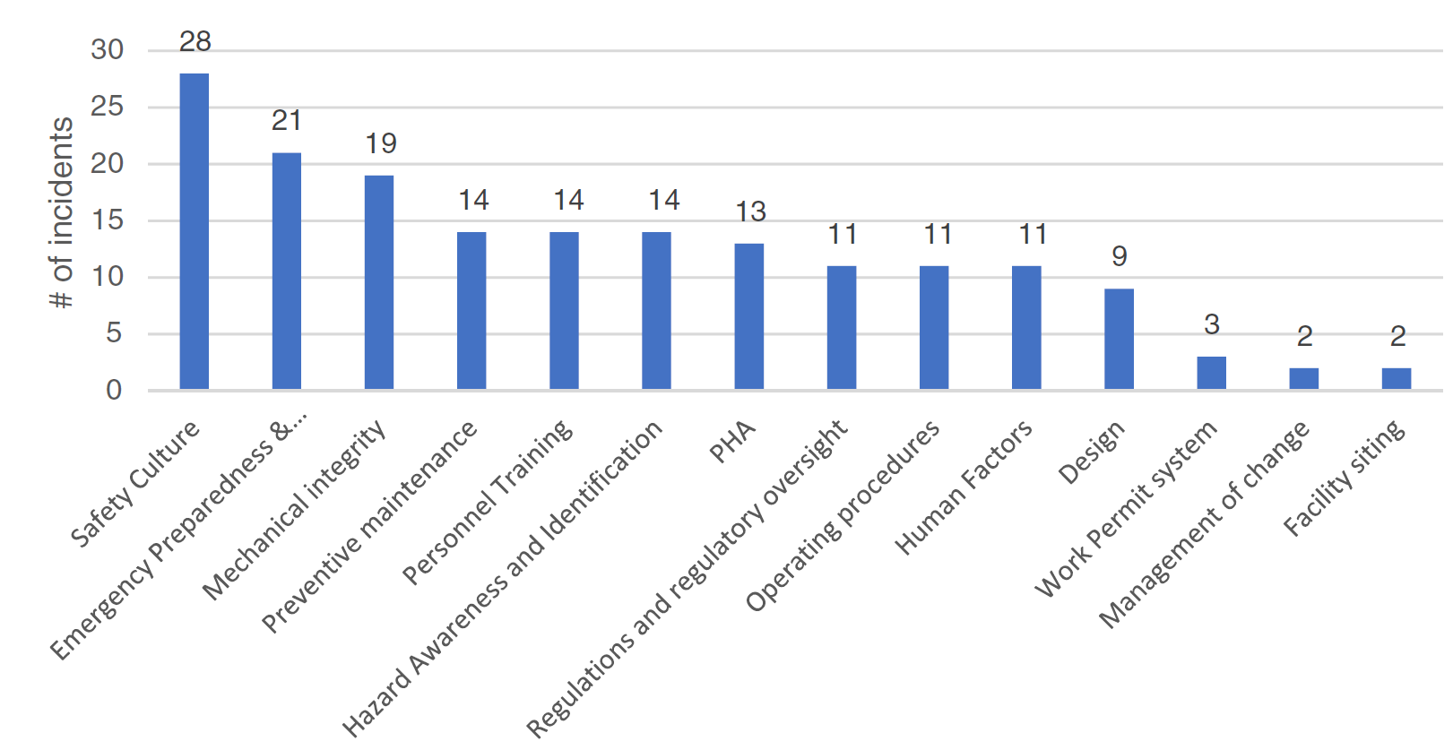
Analysis of Root Causes of Process Safety Incidents Across 14 Industries – PMP / UG
Studied: Refining, Chemicals, Oil & Gas, Storage, Pipeline, Fertilizer, Pharmaceutical, Agriculture, Food, … 3 primary incidents per industry
Analyzed significant data set in terms of root causes, fatalities, monetary damage, impact beyond plant fence, state of operation, and developed / developing country
81 incidents analyzed; identified14 primary root causes; several per incident
Published: Process Safety Progress: e12158 (2020)

Slide 14
Factors Contributing to US Chemical Plant Process Safety Incidents from 2010 – 2020*
Study analyzed the most common contributing factors to PS incidents within the chemical manufacturing sector, and relationship with the most common OSHA citations
Focused on NAICS code 325 chemical manufacturing sector cos
79 Tier-1 incidents from CSB & internal company investigations
Incidents analyzed in terms of 18 contributing factors; most common:
Also analyzed OSHA citations issued to chemical manufacturing companies and found consistent with contributing factors noted above
Most cited OSHA codes:
Published: J Loss Prevention in Process Ind, ‘21
* Study funded by the American Chemistry Council and conducted by Purdue and University of Utah
NAICS Code | Chemical Manufacturing
3251 | Basic Inorganic and Organic
3252 | Plastics, Synthetic Materials
3253 | Fertilizer and Pesticide
3254 | Pharmaceutical
3255 | Paint, Coating, Adhesive
3256 | Detergent, Sanitation
3259 | Other (Ink, Explosives, etc.)
Rank | Contributing Factor | Score
1 | Design | 6
2 | Preventive Maintenance | 6
3 | Safeguards, Controls & Layers of Protection | 5
4 | Emergency Preparedness and Response | 3
5 | Operating Procedures | 3
6 | Safety Culture | 3
Most Cited OSHA Codes (NAICS Code 325)
1910.119 - Process safety management of hazardous chemicals
1910.134 - Respiratory protection
1910.1200 - Hazard communication
1910.147 - The control of hazardous energy

Slide 15
Recent Student Publications
‘Promoting a Safe Laboratory Environment using the Reactive Hazard Evaluation & Analysis Compilation Tool (RHEACT)’, Abhijit D. Talpade, Pushkar Ghanekar, Sopuruchukwu Ezenwa, Ravi Joshi, Samuel Kravitz, Anirudh Tunga, Jayachandran Devaraj, Fabio H. Ribeiro, Ray Mentzer, accepted ACS Journal of Safety & Health, 2021.
‘Global Process Safety Incidents in the Pharmaceutical Industry’, Maaz S. Maniar, Apoorv Kumar, Ray A. Mentzer, J of Loss Prevention in the Process Industries, 68, December 2020.
‘Process Safety Incidents Across Fourteen Industries’, Anvaya Bhusari, Amous Goh, Huan Ai, Sai Sathanapally, Mehfouz Jalal, and Ray A. Mentzer, Process Safety Progress, April 2020.
‘Review of Failure Trends in the US Natural Gas Pipeline Industry: An In-depth Analysis of Transmission and Distribution System Incidents’, C. P. Vetter, L. A. Kuebel, D. Natarajan, R. A. Mentzer, J of Loss Prevention in the Process Industries 60, 2019.

Slide 16
Upcoming Student Presentations – as requested!
Friday
Elizabeth Rosene, Purdue (UG): Organizational health a new methodology and survey for measuring
Abhijit Talpade, Purdue (PhD candidate) and David Moore, AcuTech: Analysis of cybersecurity risks of proposed remote CISTAR facilities
Xinyu Zhen Purdue (PMP graduate): Safety shower and eyewash systems – best practices
Monday
Caitlin Justice, Purdue (UG): Comparison of computational models and experimental data for some reactions common to pharma industry
Pushkar Ghanekar, Purdue (PhD candidate): Promoting a safe laboratory environment using the reactive hazard evaluation and analysis compilation tool (RHEACT)

Slide 17
2020 P2SAC Closing
P2SAC continues to grow; averaging over 25 projects / year
Minimal COVID impact on progress
Companies actively engaged in working with students on research projects they suggested – THANK YOU!!
ALWAYS interested in your process safety research ideas & projects

Slide 18
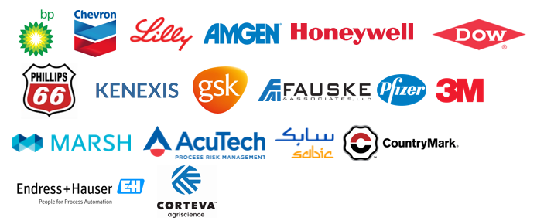
P2SAC Sponsors

